Slide 1



SMART INDIA HACKATHON 2026
GEOVAX — Intelligent Harmonisation of Multi-source Geospatial Data
▪ Problem Statement ID – SIH26013
▪ Problem Statement Title – Automated Integration and Intelligent Harmonisation of Multi-source Geospatial Data for Urban Land Record Management
▪ Theme – Smart Automation
▪ PS Category – Software
▪ Team ID – SIH1167
▪ Team Name – Perpetually Curious

Slide 2
Perpetually Curious
PROBLEM STATEMENT
Four to ten authoritative geometries per parcel — and they disagree.
THE CHALLENGE
OUR SOLUTION
WHY IT MATTERS
Four to ten geometries per parcel
Reconciled by hand in GIS
An AI-enabled platform that adjudicates — and shows its working
AI/ML Spatial Matching
Automated Topology Correction
Intelligent Attribute Mapping
No record of why a decision was made
Errors propagate silently
Claims, Not Records
Dempster–Shafer Evidence Fusion
Existing gap in current GIS workflows
Georeferencing & CRS
Change Detection & Typing
Confidence Scoring, Graded A–E
Slow cadastral finalisation
Data siloed per department
Averaging invents boundaries
Never Invents a Boundary
ULPIN + Provenance Ledger
107,262
Real features harmonised end to end
1.51 m @ 073°
Systematic inter-departmental offset recovered
99.988%
Candidate pairs eliminated by blocking
43.4%
Conflicts auto-resolved, the rest queued
14,702
ULPINs minted, every one unique
17 min 45 s
One full run on 2 vCPU / 7 GB
0
Synthetic features anywhere in the corpus
TECHNICAL NOVELTY: EVIDENCE-BASED HARMONISATION CORE
BUSINESS NOVELTY: A DEFENSIBLE RECORD, NOT A FASTER GUESS
Claims are never deleted — every decision stays re-examinable
Mass sits on “unknown”, so ignorance is visible, not hidden
Selects an observed boundary, never an averaged one
Bounded, audited topology repair — refuses beyond 0.5 m
Six-dimension explainable confidence, graded A–E per feature
ULPIN (Bhu-Aadhaar) minting with split / merge genealogy
Merkle-anchored ledger a citizen can verify independently
Adjudication queue batched by cause, ranked by decision value
Runs offline on 2 vCPU — no data centre, no external service
OGC API - Features: works in QGIS with no custom code
PROBLEM WE ADDRESS
Harmonisation of multi-source land data is manual, slow, error-prone — and preserves no reason for any decision.
→
We automate that adjudication so every published boundary carries its evidence, its confidence and its provenance.
@SIH Idea submission
1

Slide 3
Perpetually Curious
GEOVAX — Automated Geospatial Harmonisation
From Disagreeing Sources to a Defensible Land Record
Ingest + CRS
Stream real layers, profile them, put every geometry on one datum
Topology + schema
Validate, bounded repair, automatic crosswalk to a canonical schema
Match + fuse
Blocking, learned matcher, Dempster–Shafer evidence fusion
Confidence + queue
Six dimensions, graded A–E; only contested cases reach a human
Publish + verify
OGC API, ULPIN, hash-chained ledger with Merkle proofs
→
→
→
→
Every figure here is measured output of one 17-minute run on real Indian government data — no synthetic features anywhere.
WE DON’T AVERAGE. WE ADJUDICATE.
MEASURED IMPACT
CAPABILITY | GEOVAX | Manual GIS desk | ETL / conflation | GeoAI extraction
Reconciles 4+ disagreeing sources | Automatic | By hand, per parcel | Rule-based only | Single source
Records why each decision was made | Ledger + rationale | ✗ | ✗ | ✗
Separates conflict from ignorance | Dempster–Shafer | ✗ | ✗ | ✗
Refuses instead of averaging | Always, and says so | Analyst-dependent | ✗ | ✗
Per-feature confidence, graded A–E | 6 dimensions | ✗ | ✗ | Model score only
Stable identity across mutation | ULPIN genealogy | ✗ | ✗ | ✗
107,262
real features harmonised in one run
1.51 m @ 073°
systematic offset recovered automatically
99.988%
of candidate pairs eliminated by blocking
81 / 81
tests passing on the shipped codebase
INNOVATION & UNIQUENESS
BUILT DIFFERENT
Belief and plausibility
Mass sits on unknown — the right state when one source has an opinion.
The offset is found, not assumed
1.51 m @ 073° from 5,226 pairs, by median — unmoved by real change.
Refusal is a designed behaviour
702 boundaries over 10 m apart went to a human, not to a fusion.
12,700 lines of Python
30 modules, end to end on 2 vCPU / 7 GB, 81 tests passing.
Real government data only
TNGIS, NCSCM, GCC, Google Open Buildings — zero synthetic features.
Verifiable, not just published
Merkle-anchored ledger a citizen can check independently.
@SIH Idea submission
2

Slide 4
Perpetually Curious
TECHNICAL APPROACH
CORE GEOSPATIAL ENGINE
PLATFORM ARCHITECTURE
TECHNOLOGY STACK
Coordinate & Datum Engine
Everest 1830 / Kalianpur family
EPSG:7755 India NSF LCC
GCP ladder + Baarda test
PRODUCING AUTHORITIES
Drone / NAKSHA · Revenue · Municipal GIS · Utilities · GNSS · GeoAI
Python 3.11, Apache-2.0
12,700 lines · 30 modules · 81 passing tests
1 · INGEST AND PROFILE
Format connectors | Dataset profiler | CRS + datum engine | GCP rubber-sheeting
Claims, not records — nothing entering the platform is treated as fact
PostgreSQL + PostGIS
canonical store, exact topological predicates on 6 M parcels
Topology
15 validation rules
Bounded repair, refused beyond 0.5 m
Planar-partition gap scan
Shapely / GEOS + STRtree
validation, bounded repair, blocking, spatial joins
2 · HARMONISATION CORE
PROJ / pyproj
Indian datum family, EPSG:7755, EPSG:32644 measurement CRS
Topology validate + repair
Automatic schema matching
Indic transliteration
AI/ML spatial matching
Global assignment + cardinality
Entity clustering
scikit-learn HistGradientBoosting
weak-supervised, self-trained spatial matcher
Spatial Matching
Grid + STRtree blocking
Median offset removal
3 · DECISION LAYER
Which claim survives, and why — recorded either way
rasterio / GDAL COG · CityJSON 1.1
raster tier, terrain chain, LOD1 city model
Evidence Fusion
Dempster–Shafer mass construction
Independence discounting
Statutory rules R-GEO-01 / R-POR-01
Conflict mass retained
A. EVIDENCE FUSION
B. STATUTORY RULE ENGINE
C. ADJUDICATION QUEUE
FastAPI · OGC API - Features · MapLibre
platform API and the operator console
Dempster–Shafer combination
Independence discounting
Geometric fusion by evidence
629,660 claims fused
R-GEO-01 — > 10 m refused
R-POR-01 — poramboke findings
R-CTL-01 — control precedence
702 refusals in this run
20,207 cases escalated
Batched by cause, not by case
Ranked by decision value
Every decision becomes a label
OUTPUT SURFACES
OGC
OGC API - Features + GeoJSON
MVT
Vector tiles · Web-GIS console
Confidence & Identity
Six dimensions, graded A–E
ULPIN checksum + genealogy
Hash chain, Merkle inclusion proofs
Decides what survives
Encodes the law
Where humans decide
ULP
ULPIN register with genealogy
LOD1
CityJSON 1.1 3-D city model
CONFIDENCE SCORING
Six dimensions, explainable, graded A–E
QUE
Adjudication queue + GeoJSON
4 · PUBLICATION
LGR
Provenance ledger + Merkle root
PostGIS canonical store
Provenance ledger + Merkle root
OGC API - Features / STAC
Subscription bus · Web-GIS console
@SIH Idea submission
3
Notes:
The architecture point: presolve feeds three interchangeable solve paths, and all three sit on one sparse linear algebra core that exposes only two factorizations plus SpMV. That is why extension is cheap. Restore-check: the third Method bullet — dual simplex warm starts every branch-and-cut node — is the bullet that makes branch-and-cut affordable.
3

Slide 5
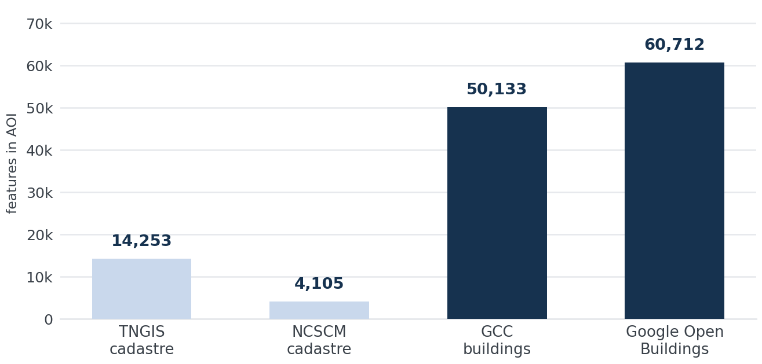
Perpetually Curious
IMPACT & BENEFITS
CORPUS SCALE
OPERATIONAL IMPACT
ECOSYSTEM & ADOPTION
4 real sources
END-TO-END HARMONISATION OF 22.3 km²
(2 vCPU · 7 GB · 12 checkpointed stages)
PROGRAMMES
DILRMP
NAKSHA
AMRUT / Bhuvan
17 min 45 s
REGISTRIES & POLICY
LGD Directory
Nat. Geospatial Policy 2022
DPDP Act 2023
Single-ULB pilot
State: 6 M+ parcels
OPEN STANDARDS
OGC API - Features · GeoJSON · CityJSON 1.1 · ISO 19107 / 19115
107,262 FEATURES PUBLISHED
PER RUN, WITH PROVENANCE
RESUMABLE, REPRODUCIBLE,
RUNS FULLY OFFLINE
DEPARTMENTS SERVED
Revenue / Survey
Municipal ULB
DoLR / State GIS
22.3 km²
Central Chennai harmonised per run
6.02 M
TNGIS parcels ingested statewide
43.4%
Conflicts closed with no human involved
0.9997
Mean topological confidence across the AOI
100%
ULPIN single-character errors detected
0
Boundaries invented by averaging
TECHNICAL BENEFITS
OPERATIONAL BENEFITS
STRATEGIC BENEFITS
STANDARDS AND STATUTORY CONFORMANCE
Reproducible, checkpointed runs
Refusals recorded, never silent
Policy replayed without re-ingest
Runs offline on district hardware
Manual reconciliation removed
Queue batched by cause, not case
Survey effort aimed by evidence
Officer decisions become training data
NAKSHA readiness measured per ward
Exchange by open standard, not export
Citizen-verifiable record integrity
Sovereign, on-premises, no lock-in
Instrument | Type | Status | How GEOVAX conforms
DILRMP | Programme | ✓ Built | 14-character ULPIN with checksum; split / merge genealogy carries encumbrance across mutation
NAKSHA — 0.5 m urban spec | Programme | ✓ Measured | Positional confidence scored against the spec; the shortfall is reported per ward, not hidden
LGD hierarchy (MoPR) | Registry | ✓ Built | state / district / taluk / village LGD codes are the canonical join key
Nat. Geospatial Policy 2022 | Policy | ✓ Built | EPSG:7755 India NSF LCC is a first-class target CRS; open standards throughout
DPDP Act 2023 | Statute | ✓ Built | Owner attributes absent from the feature API; purpose-bound, logged access only
OGC API - Features Part 1 | Standard | ✓ Conformant | /conformance, /collections, /items — QGIS works with no custom code
CityGML LOD1 / CityJSON 1.1 | Standard | ✓ Built | Solid geometry, measuredHeight, storeysAboveGround — 61,066 extruded
STAC catalogue | Standard | ⚙ Designed | Item structure designed, not built here — stated rather than implied
WHERE IT
APPLIES
Cadastral finalisation
Mutation & subdivision
NAKSHA survey planning
Encroachment findings
Development control
Utility coordination
Inter-dept. exchange
Citizen verification
@SIH Idea submission
4

Slide 6
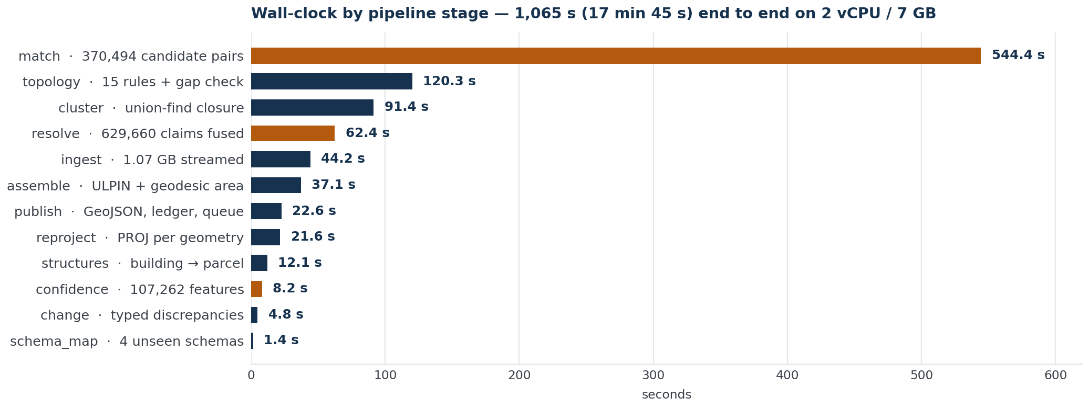
Perpetually Curious
FEASIBILITY AND VIABILITY
ONE 17-MINUTE RUN · 107,262 FEATURES · 2 vCPU
AND THE 56.6% IT REFUSES TO CLOSE WITHOUT A HUMAN
ACCURACY
Matcher AUC 1.0000, expected calibration error 0.0002 over 5-fold CV
1.51 m @ 073° offset recovered from 5,226 pairs, residual RMS 2.51 m
Mean topological confidence 0.9997; ULPIN checksum catches 100% of typos
nDSM median 0.023 m — the derived ground surface sits on the ground
EFFICIENCY
Blocking removes 99.988% of 3.04 × 10⁹ pairs before a feature is computed
A 1.07 GB cadastral file is streamed in ~40 MB of RAM, not loaded
107,262 features harmonised in 1,065 s on 2 vCPU — no GPU, no cluster
12 checkpointed stages on 2 vCPU / 7 GB. Matching dominates because 370,494 candidate pairs are scored — after blocking removed 99.988% of the 3.04 × 10⁹ possible.
PERFORMANCE
43.4% of 35,690 conflicts auto-resolved; 20,207 escalated, batched into 2 causes
Change detector's measured false-positive rate 1.79% on a null-change experiment
61,066 buildings extruded to LOD1; 31,494 with no height emitted flat and flagged
VIABILITY
Licensing — Apache-2.0, and every input layer is CC0-1.0 or CC-BY-4.0 — nothing blocks a deployment.
Deployment — Python 3.11 + PostGIS via docker-compose; runs offline in a district office on 2 vCPU.
Adoption path — OGC API - Features, so a department works against it in QGIS with no GEOVAX-specific code.
Sizing — A measured path from a single-ULB pilot (< 500 k parcels) to Tamil Nadu statewide (6 M+).
Maintainability — 81 passing tests, per-stage checkpoints, an AOI manifest with SHA-256 for every input.
Institutional fit — The LGD hierarchy is the join key throughout, so multi-ULB isolation is configuration, not a rewrite.
RISKS AND MITIGATION
No independent ground truth — CV figures are against the platform's own weak labels. A pilot's first week is a 200–300 point control survey; everything downstream then becomes empirical.
Declared accuracies may be aspirational — Every fusion weight is anchored to them — which is why ground truth comes first.
A queue nobody works — 56.6% needs a human. Batching by cause makes the workload tractable; it cannot make it zero.
No Indian float DSM openly available — The terrain chain is proved on a real calibrated surface (Geobasis NRW DOM1) and labelled as such.
AMRUT layer contributes zero features here — Reported as a completeness gap, not silently run with three sources where four were configured.
@SIH Idea submission
5

Slide 7
Perpetually Curious
RESEARCH AND REFERENCES
Read the middle track first — what is designed but not built is stated, not implied
STAGE 1
✓ built
STAGE 2
✓ built
STAGE 3
✓ built
STAGE 4
✓ built
STAGE 5
BUILT AND MEASURED
→
→
→
→
✓ built
Ingest + CRS
Topology + schema
Match + fuse
Confidence + queue
Publish + ledger
DESIGNED, NOT BUILT
ITEM A
→
ITEM B
→
ITEM C
STAC catalogue
Subscription bus
Adjudication write path
DEPLOYMENT PATH
NEXT 1
Ground-truth control survey
DATA SOURCES AND STANDARDS
METHOD REFERENCES · EVIDENCE, MATCHING, LEARNING
METHOD REFERENCES · GEODESY, RASTER, QUALITY, INTEGRITY
TNGIS Tamil Nadu cadastrals — TNeGA · CC0-1.0 · 6.02 M parcels · github.com/ramSeraph/indian_cadastrals
NCSCM coastal cadastrals — MoEFCC · CC0-1.0 · 220,668 parcels · ncscm.res.in
Greater Chennai Corporation footprints — GCC via TNGIS · CC0-1.0 · 964,053 · github.com/ramSeraph/indian_buildings
Google Open Buildings v3 — CC-BY-4.0 / ODbL-1.0 · sites.research.google/gr/open-buildings
AMRUT / Bhuvan urban buildings — NRSC, ISRO · bhuvan.nrsc.gov.in
Geobasis NRW DOM1 float DSM — Bezirksregierung Köln · dl-de/by-2-0 · 1 m grid · opengeodata.nrw.de
Local Government Directory — Ministry of Panchayati Raj · lgdirectory.gov.in
OGC API - Features Part 1: Core — ISO 19168-1 · ogcapi.ogc.org/features
Formats and quality standards — GeoJSON · CityJSON 1.1 · COG · ISO 19107 / 19115 / 19157 · rfc-editor.org/rfc/rfc7946
Statute and programme — DILRMP · NAKSHA (DoLR) · NGP 2022 · DPDP Act 2023 · TN CDBR 2019 · SoI CORS
Dempster (1967) — Upper and lower probabilities induced by a multivalued mapping. Ann. Math. Statist. 38(2):325–339. doi.org/10.1214/aoms/1177698950
Shafer (1976) — A Mathematical Theory of Evidence. Princeton University Press. jstor.org/stable/j.ctv10vm1qb
Ratner, Bach, Ehrenberg, Fries, Wu & Ré (2017) — Snorkel: rapid training data creation with weak supervision. PVLDB 11(3):269–282. doi.org/10.14778/3157794.3157797
Friedman (2001) — Greedy function approximation: a gradient boosting machine. Ann. Statist. 29(5):1189–1232. doi.org/10.1214/aos/1013203451
Jonker & Volgenant (1987) — A shortest augmenting path algorithm for dense and sparse linear assignment problems. Computing 38(4):325–340. doi.org/10.1007/BF02278710
Crouse (2016) — On implementing 2D rectangular assignment algorithms. IEEE Trans. Aerosp. Electron. Syst. 52(4):1679–1696. doi.org/10.1109/TAES.2016.140952
Baarda (1968) — A testing procedure for use in geodetic networks. Netherlands Geodetic Commission, Publications on Geodesy 9. doi.org/10.54419/t8w4sg
Horn (1987) — Closed-form solution of absolute orientation using unit quaternions. J. Opt. Soc. Am. A 4(4):629–642. doi.org/10.1364/JOSAA.4.000629
Zhang, Chen, Whitman, Shyu, Yan & Zhang (2003) — A progressive morphological filter for removing nonground measurements from airborne LIDAR data. IEEE TGRS 41(4):872–882. doi.org/10.1109/TGRS.2003.810682
Zitová & Flusser (2003) — Image registration methods: a survey. Image and Vision Computing 21(11):977–1000. doi.org/10.1016/S0262-8856(03)00137-9
Foroosh, Zerubia & Berthod (2002) — Extension of phase correlation to subpixel registration. IEEE Trans. Image Process. 11(3):188–200. doi.org/10.1109/83.988953
Moran (1950) — Notes on continuous stochastic phenomena. Biometrika 37(1–2):17–23. doi.org/10.1093/biomet/37.1-2.17
Merkle (1988) — A digital signature based on a conventional encryption function. CRYPTO ’87, LNCS 293:369–378. doi.org/10.1007/3-540-48184-2_32
@SIH Idea submission
6

